Slide 1
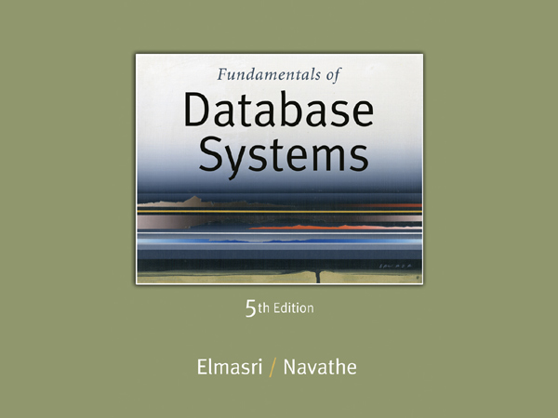

Slide 2
Chapter 6
The Relational Algebra

Slide 3
6.2 Relational Algebra Operations from
Set Theory
UNION Operation
  Binary operation, denoted by ∪
  The result of R ∪ S, is a relation that includes all tuples that are either in R or in S or in both R and S
  Duplicate tuples are eliminated
  The two operand relations R and S must be “type compatible” (or UNION compatible)
    R and S must have same number of attributes
    Each pair of corresponding attributes must be type compatible (have same or compatible domains)

Slide 4
Relational Algebra Operations from
Set Theory: UNION
Example:
  Find the full name of the employees who either work in department 5 or department 4
  We can use the UNION operation as follows:
DEP4_EMPS ← σ_{DNO=4} (EMPLOYEE)
R1 ← π _{Fname,Minit,Lname}(DEP4_EMPS)
DEP5_EMPS ← σ_{DNO=5} (EMPLOYEE)
R2 ← π _{Fname,Minit,Lname}(DEP5_EMPS)
R← R1 ∪ R2
  The union operation produces the tuples that are in either R1 or R2 or both

Slide 5
In one line
R ←(π _{Fname,Minit,Lname} (σ_{DNO=4} (EMPLOYEE)) U π _{Fname,Minit,Lname} (σ_{DNO=5} (EMPLOYEE))

Slide 6
Relational Algebra Operations from
Set Theory: UNION
Example:
  To retrieve the social security numbers of all employees who either work in department 5 (RESULT1 below) or directly supervise an employee who works in department 5 (RESULT2 below)
  We can use the UNION operation as follows:
DEP5_EMPS ← σ_{DNO=5} (EMPLOYEE)
RESULT1 ← π _{SSN}(DEP5_EMPS)
RESULT2(SSN) ← π_{SUPERSSN}(DEP5_EMPS)
RESULT ← RESULT1 ∪ RESULT2
  The union operation produces the tuples that are in either RESULT1 or RESULT2 or both

Slide 7
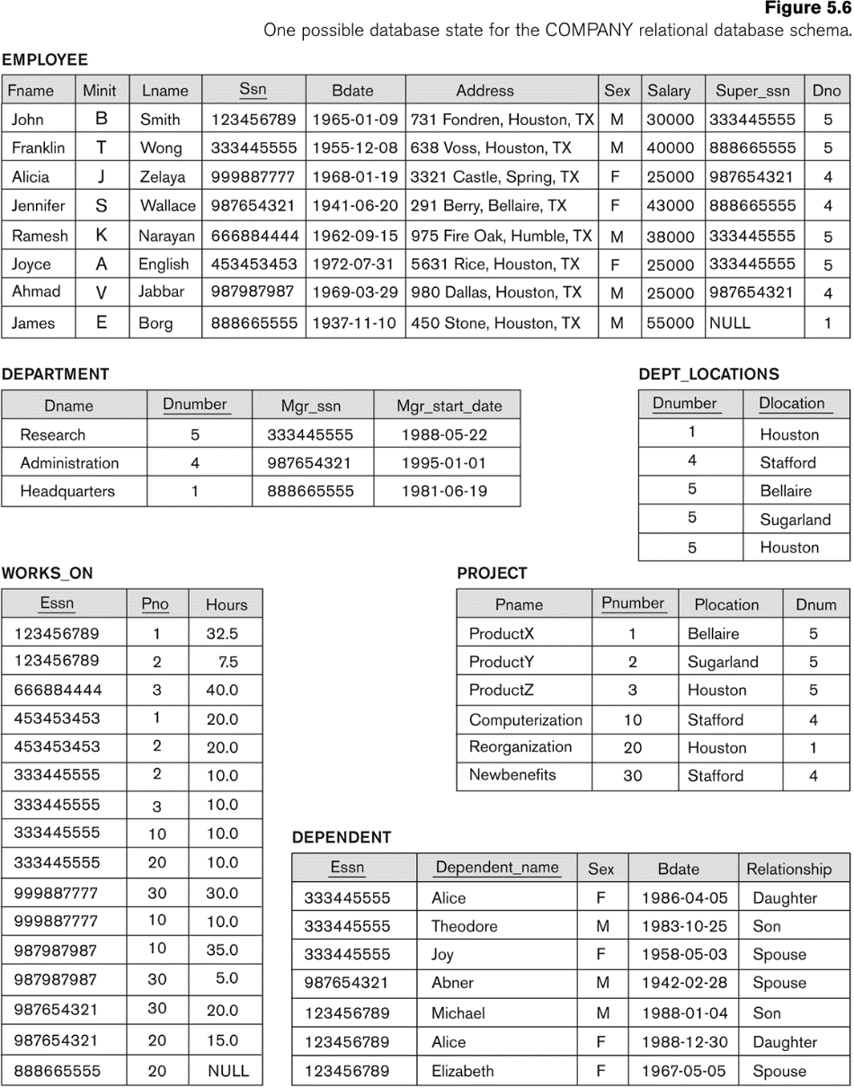

Slide 8
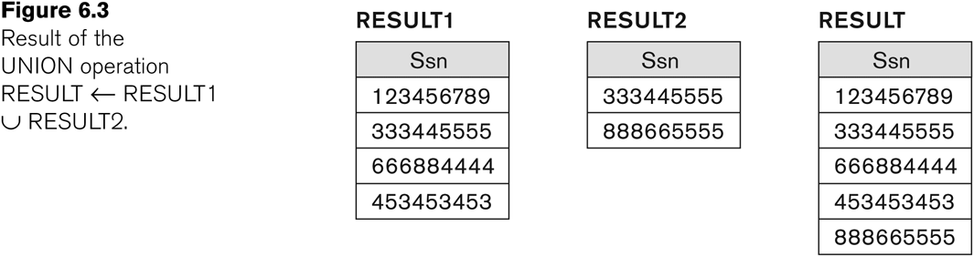
Example of the result of a UNION operation
UNION Example

Slide 9
Relational Algebra Operations from
Set Theory
Type Compatibility of operands is required for the binary set operation UNION ∪, (also for INTERSECTION ∩, and SET DIFFERENCE –, see next slides)
R1(A1, A2, ..., An) and R2(B1, B2, ..., Bn) are type compatible if:
  they have the same number of attributes, and
  the domains of corresponding attributes are type compatible (i.e. dom(Ai)=dom(Bi) for i=1, 2, ..., n).
The resulting relation for R1∪R2 (also for R1∩R2, or R1–R2, see next slides) has the same attribute names as the first operand relation R1 (by convention)

Slide 10
Relational Algebra Operations from Set Theory: INTERSECTION
INTERSECTION is denoted by ∩
The result of the operation R ∩ S, is a relation that includes all tuples that are in both R and S
  The attribute names in the result will be the same as the attribute names in R
The two operand relations R and S must be “type compatible”

Slide 11
Relational Algebra Operations from Set Theory: SET DIFFERENCE (cont.)
SET DIFFERENCE (also called MINUS or EXCEPT) is denoted by –
The result of R – S, is a relation that includes all tuples that are in R but not in S
  The attribute names in the result will be the same as the attribute names in R
The two operand relations R and S must be “type compatible”

Slide 12
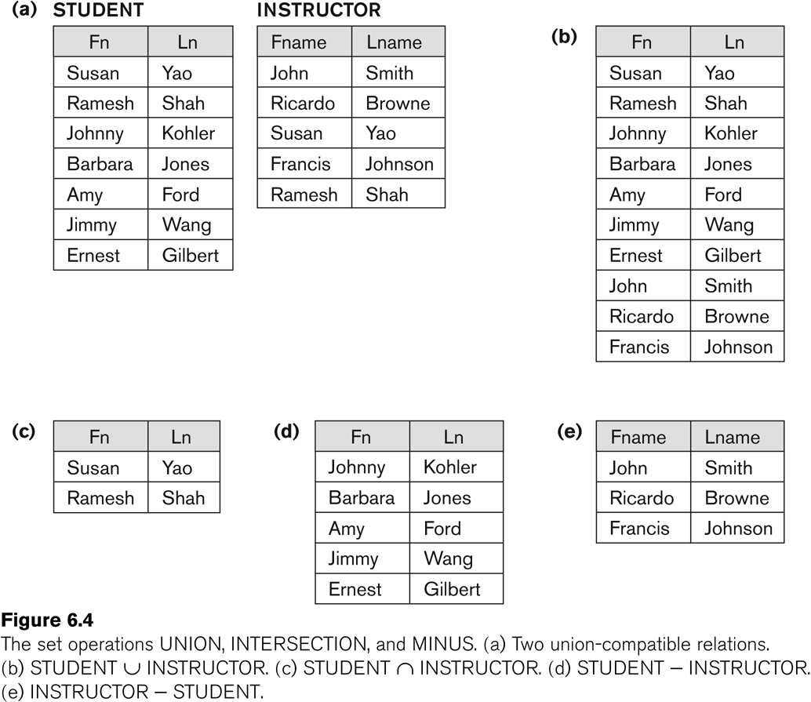
Example to illustrate the result of UNION, INTERSECT, and DIFFERENCE

Slide 13
Some properties of UNION, INTERSECT, and DIFFERENCE
Notice that both union and intersection are commutative operations; that is
  R ∪ S = S ∪ R, and R ∩ S = S ∩ R
Both union and intersection can be treated as n-ary operations applicable to any number of relations as both are associative operations; that is
  R ∪ (S ∪ T) = (R ∪ S) ∪ T
  (R ∩ S) ∩ T = R ∩ (S ∩ T)
The minus operation is not commutative; that is, in general
  R – S ≠ S – R

Slide 14
Relational Algebra Operations from Set Theory: CARTESIAN PRODUCT
CARTESIAN (or CROSS) PRODUCT Operation
  This operation is used to combine tuples from two relations in a combinatorial fashion.
  Denoted by R(A1, A2, . . ., An) x S(B1, B2, . . ., Bm)
  Result is a relation Q with degree n + m attributes:
    Q(A1, A2, . . ., An, B1, B2, . . ., Bm), in that order.
  The resulting relation state has one tuple for each combination of tuples—one from R and one from S.
  Hence, if R has n_{R} tuples (denoted as |R| = n_{R} ), and S has n_{S} tuples, then R x S will have n_{R} * n_{S} tuples.
  The two operands do NOT have to be "type compatible”

Slide 15
6.3 Binary Relational Operations: JOIN
JOIN Operation (denoted by )
  The sequence of CARTESIAN PRODECT followed by SELECT is used quite commonly to identify and select related tuples from two relations
  A special operation, called JOIN combines this sequence into a single operation
  This operation is very important for any relational database with more than a single relation, because it allows us combine related tuples from various relations
  The general form of a join operation on two relations R(A1, A2, . . ., An) and S(B1, B2, . . ., Bm) is:
  R _{<join condition>}S
  where R and S can be any relations that result from general relational algebra expressions.

Slide 16
Binary Relational Operations: JOIN (cont.)
Example: Suppose that we want to retrieve the name of the manager of each department.
  To get the manager’s name, we need to combine each DEPARTMENT tuple with the EMPLOYEE tuple whose SSN value matches the MGRSSN value in the department tuple.
  We do this by using the join operation.
  DEPT_MGR ← DEPARTMENT _{MGRSSN=SSN} EMPLOYEE
MGRSSN=SSN is the join condition
  Combines each department record with the employee who manages the department
  The join condition can also be specified as DEPARTMENT.MGRSSN= EMPLOYEE.SSN

Slide 17
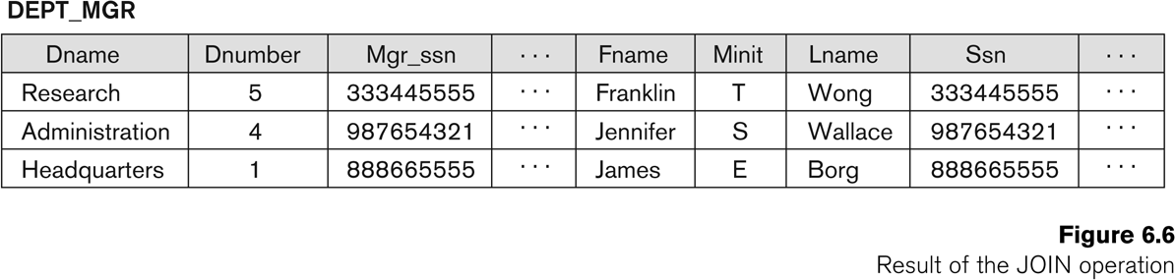

Example of applying the JOIN operation
DEPT_MGR ← DEPARTMENT _{MGRSSN=SSN} EMPLOYEE

Slide 18
Some properties of JOIN
Consider the following JOIN operation:
  R(A1, A2, . . ., An) S(B1, B2, . . ., Bm)
    R.Ai=S.Bj
  Result is a relation Q with degree n + m attributes:
    Q(A1, A2, . . ., An, B1, B2, . . ., Bm), in that order.
  The resulting relation state has one tuple for each combination of tuples—r from R and s from S, but only if they satisfy the join condition r[Ai]=s[Bj]
  Hence, if R has n_{R} tuples, and S has n_{S} tuples, then the join result will generally have less than n_{R} * n_{S} tuples.
  Only related tuples (based on the join condition) will appear in the result

Slide 19
Examples of Queries in Relational Algebra : Procedural Form
Q1: Retrieve the name and address of all employees who work for the ‘Research’ department.
RESEARCH_DEPT ← σ DNAME=’Research’ (DEPARTMENT)
RESEARCH_EMPS ← (RESEARCH_DEPT _{DNUMBER= DNOEMPLOYEE}EMPLOYEE)
RESULT ← π FNAME, LNAME, ADDRESS (RESEARCH_EMPS)
As a single expression, these queries become:
Q1: Retrieve the name and address of all employees who work for the ‘Research’ department.
π _{Fname, Lname, Address} (σ Dname= ‘Research’
(DEPARTMENT Dnumber=Dno(EMPLOYEE))

Slide 20
